Slide 1
Divide and Conquer Strategy
Divide the problem into a number of smaller subproblems.
Solve the smaller subproblems.
Combine the solution of the smaller subproblems to obtain the solution of the original problem.

Slide 2
Problem: Given a set of n numbers, S, develop an algorithm to find the maximum and the minimum numbers in the set. For the sake of simplicity we assume n is a power of 2
Algorithm MaxMin1
  Step1: Using the algorithm FindMax, compute the maximum number, MaxNum, in the set S.
  Step2: Remove MaxNum from the set S and call the new set S’.
  Step3: Modify the algorithm FindMax to FindMin and use it to compute the minimum number in the set S’.
Basic Operation: Comparison between numbers
  How many basic operations are performed?
  Answer: (n-1) + (n-2) = 2n -3

Slide 3
Given n elements X[1], …, X[n], the algorithm finds m and j such that m = X[j] = max _{1<=k<=n} X[k], and for which j is as large as possible.
Algorithm FindMax
Step 1. Set j ← n, k ← n – 1, m ← X[n]
Step 2. If k=0, the algorithm terminates.
Step 3. If X[k] <= m, go to step 5.
Step 4. Set j ← k, m ← X[k].
Step 5. Decrease k by 1, and return to step 2

Slide 4
Second algorithm to find the maximum and minimum number in the set S. For sake of simplicity we assume n is a power of 2
Algorithm FindMaxMin(S)
Begin
1. Split S into two sets S1 and S2 of equal size.
2. FindMaxMin(S1); Suppose MAX1 and MIN1 are the
maximum and minimum of S1.
3. FindMaxMin(S2); Suppose MAX2 and MIN2 are the
maximum and minimum of S2.
4. return (MAX= max(MAX1,MAX2), MIN= min(MIN1,
MIN2)).
End

Slide 6
Complexity of the Algorithm FindMaxMin
Basic Operations: Comparisons between numbers
Suppose, that the number of basic operations needed to find the maximum and the minimum of the set S is T(n)
Then, the number of basic operations needed to find the maximum and the minimum of the set S₁ is T(n/2)
And the number of basic operations needed to find the maximum and the minimum of the set S₂ is T(n/2)
Once the maximums and the minimums of the sets S₁ and S₂ are computed, two additional comparisons are needed
Therefore, T(n) = 2T(n/2) + 2 for n > 2 and T(2) = 1

Slide 7
Tower of Hanoi Problem
Given three pegs A, B and C, and n disks placed in the peg
A. The problem is to transfer all n disks from A to B, using
C as an intermediate peg.
Constraints: (i) Only one disk can be moved at a time.
(ii) A larger disk cannot be placed on top of a
smaller disk.
Algorithm:
Move the top (n-1) disks from A to C using B as an intermediate peg.
Move the largest disk from A to B.
Move (n-1) disks from C to B using A as an intermediate peg.

Slide 8
Given a sequence of n numbers, the following algorithm sorts the sequence in ascending order. For sake of simplicity we assume that n is a power of 2.
Algorithm Sort(S)
if |S| = 2 then compare the two numbers and return (min,max)
else
begin
1. Pick an arbitrary element s_{k} of the sequence S.
2. Divide S into parts S₁, S₂, S₃ such that the elements of S₁, S₂,and S₃ are less than, equal to and greater than s_{k} respectively.
3. return (Sort(S₁),S₂,Sort(S₃))
end

Slide 9
S
S₁
S₂
S₃
Size of S = n
Size of S₁
  Smallest = 0
  Largest = n-1
Size of S₃
  Smallest = 0
  Largest = n-1

Slide 10
Given a sequence of n numbers, the following algorithm sorts the sequence in ascending order. For the sake of simplicity we assume that n is a power of 2.
Algorithm MergeSort(S)
if |S| =1 then
return (S);
else
Divide S into two sequences S1 and S2 of equal size;
return (merge (MergeSort(S1),
MergeSort(S2));

Slide 11
Recurrence Relations and Divide and Conquer Technique
There are three components of the Divide and Conquer technique
  Divide the problem into sub-problems
  Solve the sub-problems
  Combine the solutions of the sub-problems to obtain the solution of the original problem
Total time taken by a Divide and Conquer algorithm will have contribution from each of the three components
  Time to divide the problem into sub-problem
  Time to solve the sub-problems
    How many sub-problems?
    What is a size of the sub-problems?
  Time to combine the solutions of the sub-problems

Slide 12
Recurrence Relations and Divide and Conquer Technique
Total time taken by a Divide and Conquer algorithm will have contribution from each of the three components
  Time to divide the problem into sub-problem
    It will be some function of the problem size n, Let’s say d₁(n)
  Time to solve the sub-problems
    How many sub-problems? Let’s say ‘a’ sub-problems
    What is a size of the sub-problems? Let’s say ‘n/b’, where b is a constant
  Time to combine the solutions of the sub-problems
    It will be some function of the problem size n, Let’s say d₂(n)
If T(n) is the time taken by the algorithm to solve a problem of size n then
  T(n) = aT(n/b) + d₁(n) + d₂(n) = aT(n/b) + d(n),
  where d(n) = d₁(n) + d₂(n)

Slide 13
Recurrence Relations and Divide and Conquer Technique
If T(n) is the time taken by the algorithm to solve a problem of size n then
  T(n) = aT(n/b) + d₁(n) + d₂(n) = aT(n/b) + d(n),
  where
    a: the number of sub-problems
    b: n/b is the size of the sub-problem
    d(n) = amount of computational time needed to divide the problem to sub-problems and to re-combine the solution of the sub-problems to obtain the solution of the original problem

Slide 14
Algorithm Binary Search: Given a table of records whose keys are in increasing order K₁<K₂<…<K_{n}, this algorithm searches for a given key K
S1. [Initialize] Set l=1, u=n.
S2. [Get midpoint] if u<l, the algorithm terminates unsuccessfully. Otherwise, i=(l+u)/2, the approximate midpoint of the relevant table area.
S3. [Compare] If K<K_{i}, go to S4; if K>K_{i}, go to S5; and if K=K_{i}, the algorithm terminates successfully.
S4. [Adjust u] Set u=i-1, and return to S2.
S5. [Adjust l] Set l=i+1, and return to S2.

Slide 15
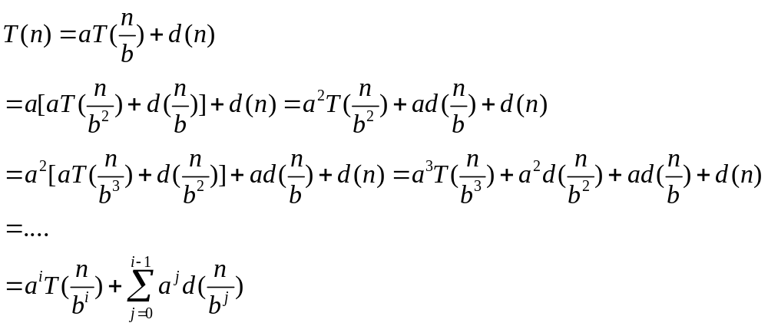
A General Solution for a Large Class of Recurrences
If T(n) is the time to solve a problem of size n, and T(1)=1, T(n)=aT(n/b)+d(n), then

Slide 16
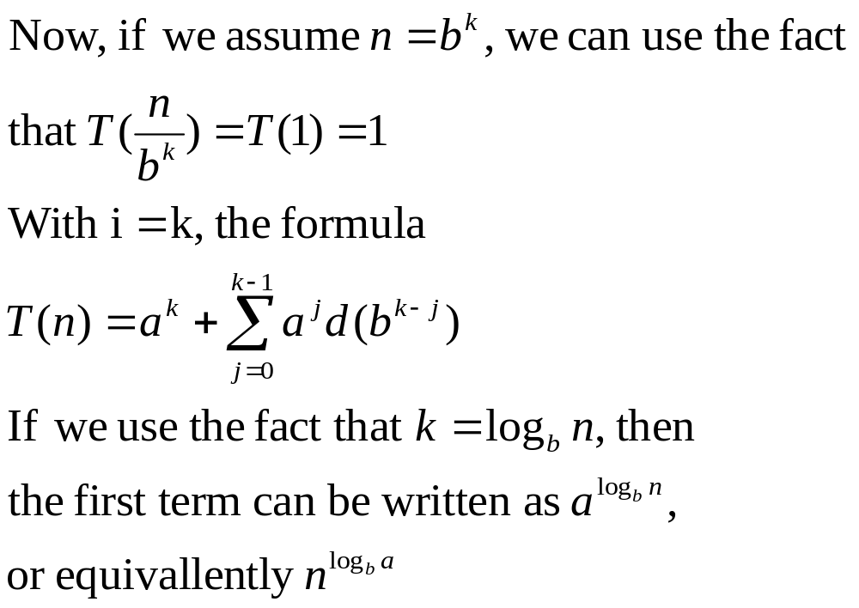

Slide 17
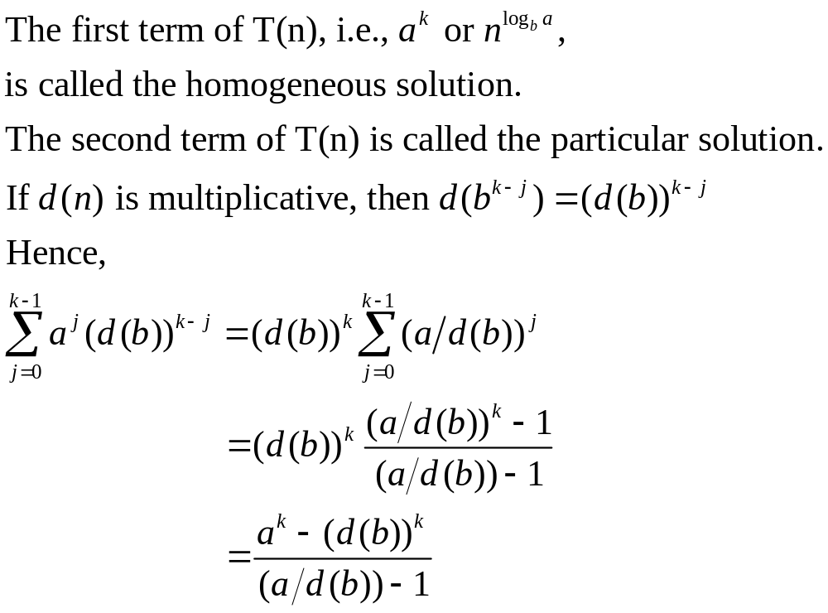
Homogeneous and Particular Solutions

Slide 18
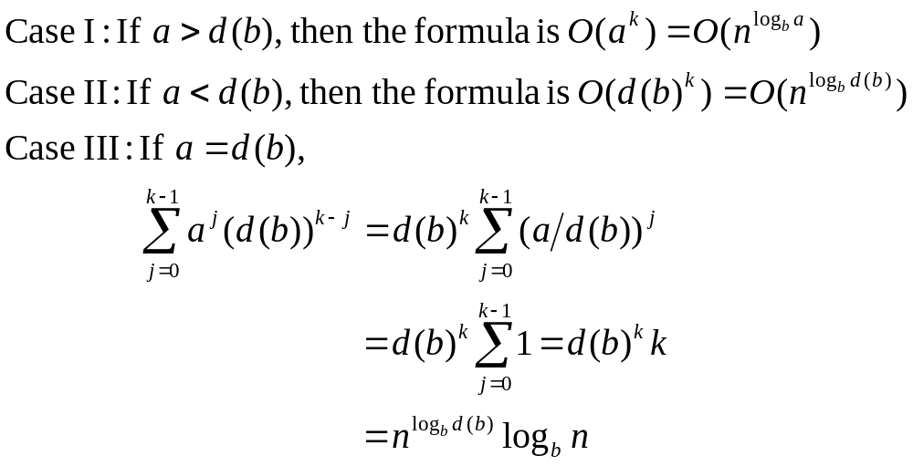
Three Cases

Slide 19
Multiplicative Functions
A function f for integers is multiplicative if f(xy) = f(x) f(y) for all positive integers x and y.
Example: f(n) = n^{k}, f(x) = x^{k}, f(y) = y^{k},
f(xy) = (xy)^{k} = x^{k}y^{k} = f(x) f(y)

Slide 20
Rule of Thumb
Driving function < Homogeneous solution | Particular solution grows at the same rate as the homogeneous solution
Driving function > Homogeneous solution by more than n^{c}; c>0 | Particular solution grows at the same rate as the driving function
Driving function = Homogeneous solution or grows faster by at most log^{k}n for some k | Particular solution grows as log n times the driving function

Slide 21
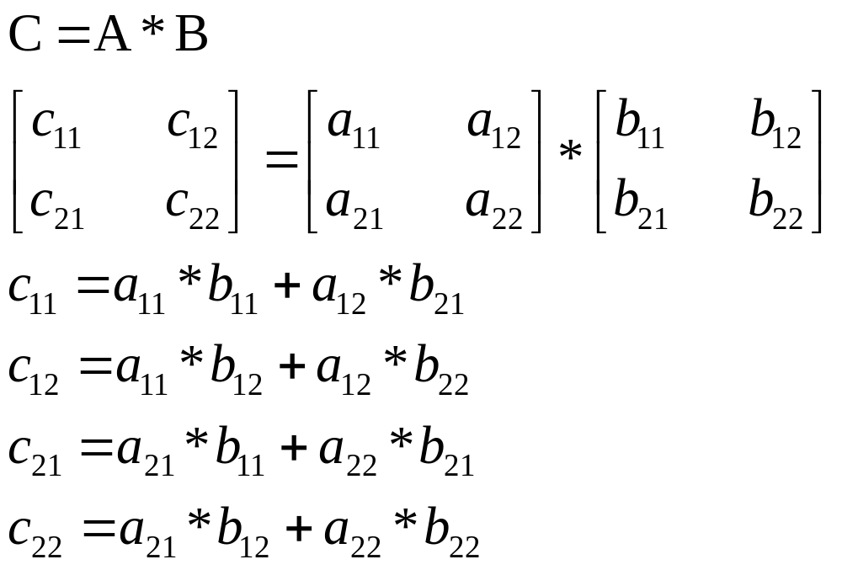
Strassen’s Matrix Multiplication Algorithm

Slide 22
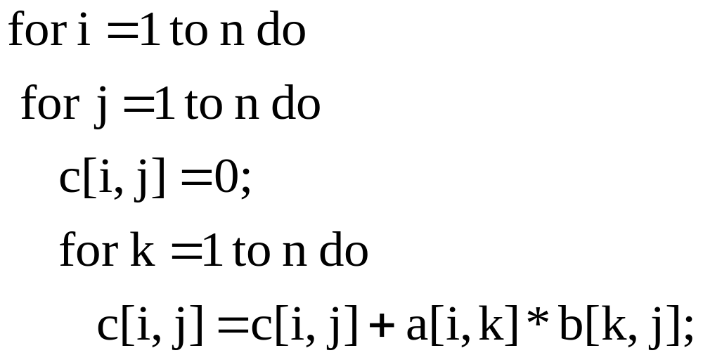
Conventional Algorithm for Matrix Multiplication
A and B are n×n matrices
Computational Complexity O(n³)

Slide 23
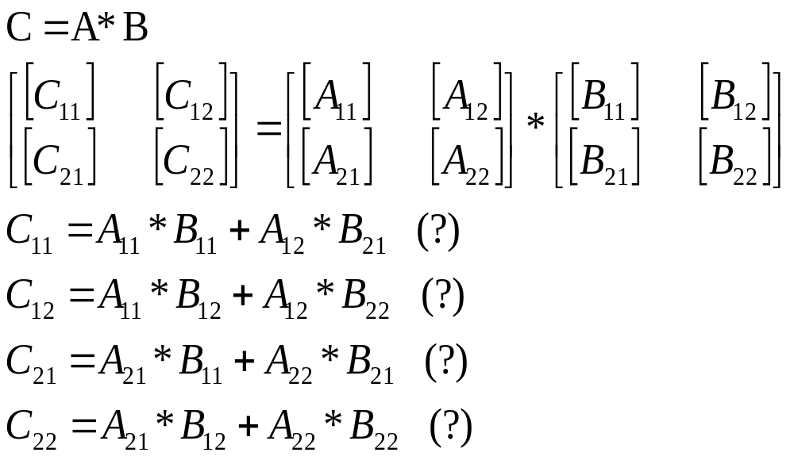
The n×n matrix A can be viewed as composed of
4 (n/2)×(n/2) matrices A₁₁, A₁₂, A₂₁ and A₂₂.
Same can be said about the matrices B and C.
Does the product relations that hold for the individual elements, also hold for the matrices?

Slide 24
Strassen’s Matrix Multiplication
If the product relations that hold for the individual elements, also hold for the matrices, then can we develop a divide-and-conquer technique based algorithm for matrix multiplication?
  Answer: yes
The original n×n matrix multiplication problem can divided into sub-problems of (n/2)×(n/2) matrix multiplication problem.
How many sub-problems?
  Answer: 8
What is the computational effort needed to divide the problem into sub-problems and combine the solution of the sub-problems to obtain the solution of the original problem?
  Answer: O(n²)
Does this approach lead to a more efficient solution for the matrix multiplication problem?
  Answer: Not obvious

Slide 25
Strassen’s Matrix Multiplication
Suppose T(n) is the computational time needed to find the product of two n×n matrices.
Can we set up a recurrence relation to find T(n)?
  Answer: yes
How is the recurrence relation going to look like?
  Answer: T(n) = 8T(n/2) + n²
Did we develop a more efficient algorithm?
  Answer: No
  Why:
    Answer: Because computational complexity is still O(n³).
What good did divide-and-conquer approach do?
  Answer: Not much
What would have helped?
  Answer: If the problem could have been solved by solving less than 8 subproblems.
Is it possible to do that?
  Answer: Yes, Strassen showed how to do it.

Slide 26
The n×n matrix A can be viewed as composed of
4 (n/2)×(n/2) matrices A₁₁, A₁₂, A₂₁ and A₂₂.
Same can be said about the matrices B and C.
Does the product relations that hold for the individual elements, also hold for the matrices?

Slide 27
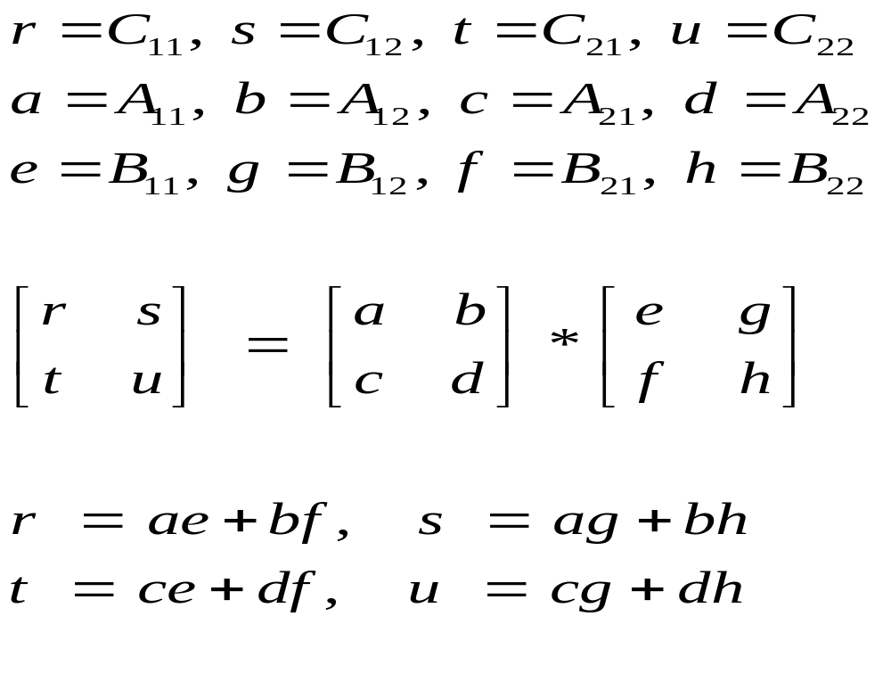
Notation used in the textbook

Slide 28
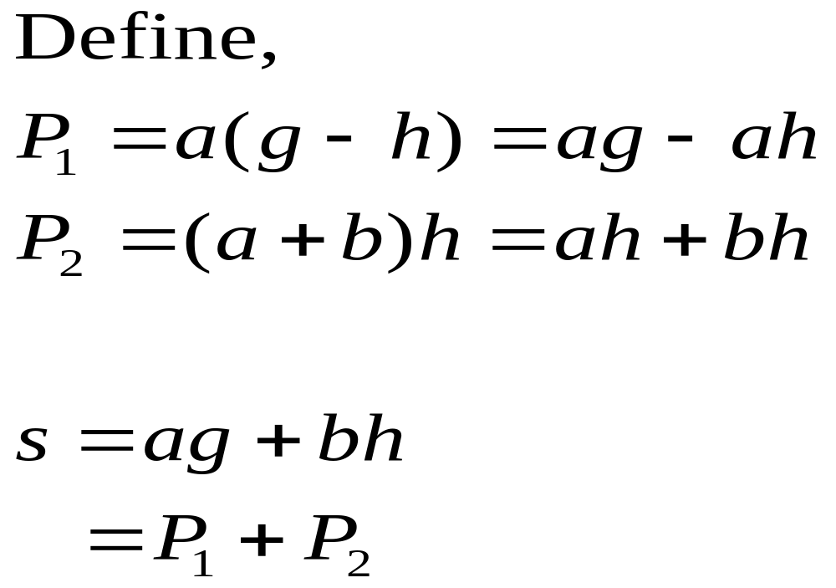

Slide 29
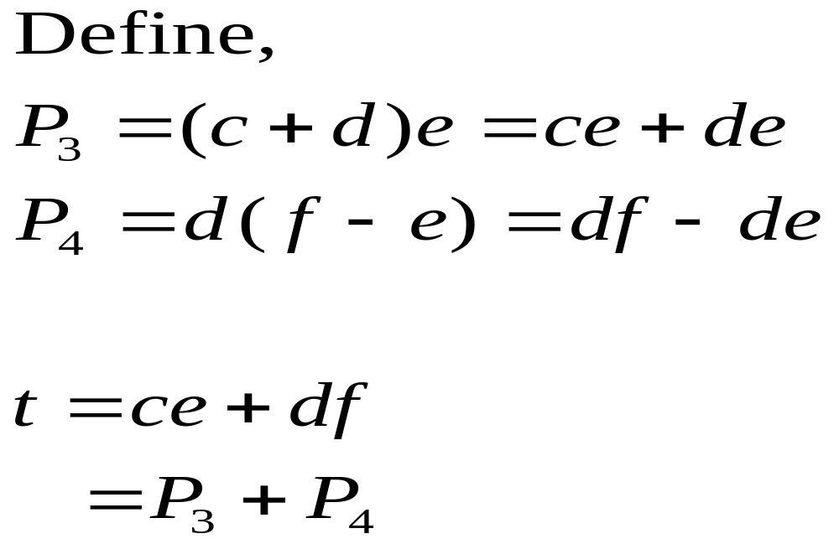

Slide 30
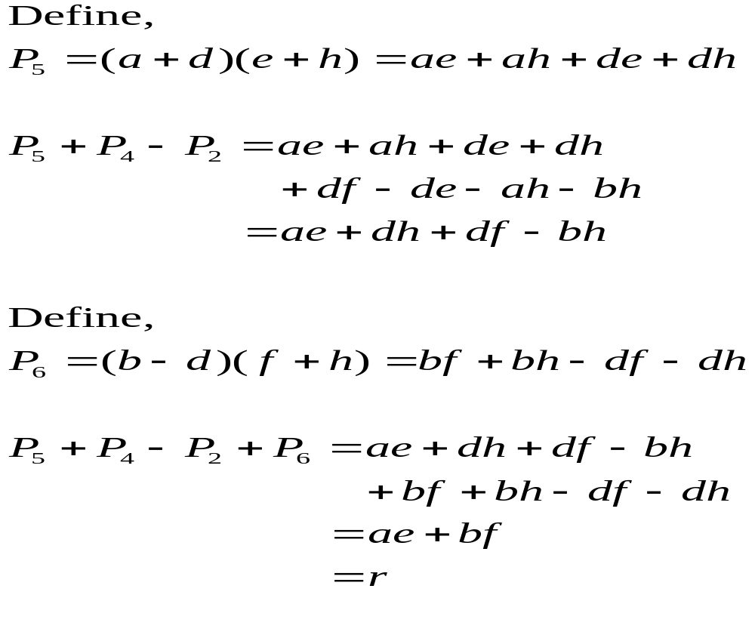

Slide 31
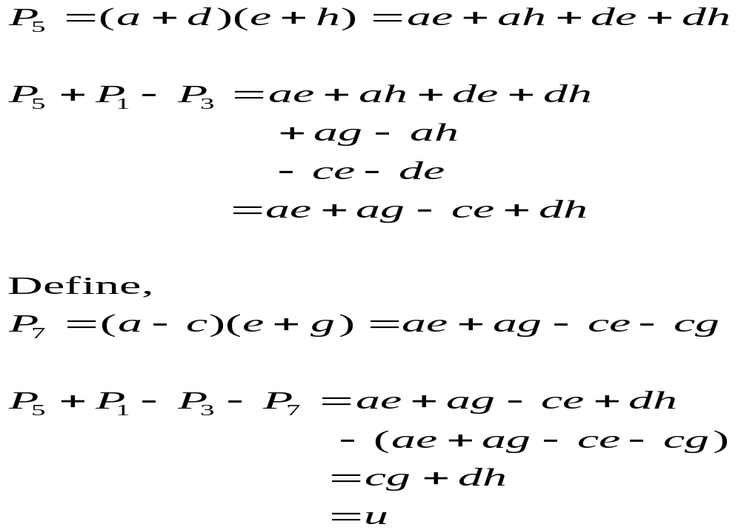

Slide 32
Strassen’s Matrix Multiplication
The number of sub-problems have been reduced from 8 to 7.
What is the big deal?
The big deal is the fact that the recurrence relation is now going to look like
  T(n) = 7T(n/2) + n²
Did Strasen develop a more efficient algorithm?
  Answer: Yes
  Why:
    Answer: Because computational complexity is now O(n^{2.81}).
Complexity of matrix multiplication algorithms are coming down ever since Strassen
Best algorithms known currently have computational complexity O(n^{2.36})
Why spend time trying to design better algorithms for matrix multiplication?
  Because very large matrices have to be multiplied in many different applications

